Slide 1
Recommendation System for mental wellbeing
Team Name: Helium-3
Team:
A.Anudeep(160719733011)
M.N.Akarshana(160719733040)
M.Sai Dhanush(160719733043)
Under the Guidance of:
G. Saritha Asst.Professor

Slide 2
INTRODUCTION
1

Slide 3
The most connected generation in history is also the loneliest

Slide 4
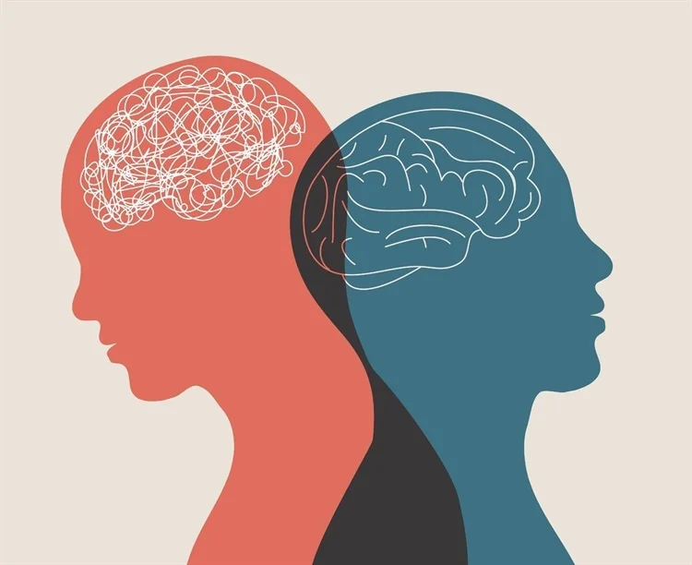
MENTAL HEALTH
Mental health includes our emotional, psychological, and social well-being. It affects how we think, feel, and act. It also helps determine how we handle stress, relate to others, and make healthy choices.
Mental health disorders are medical issues that adversely affect a person’s cognitive, emotional, and relational health, and disrupt daily functioning. A host of risk factors have been recognized as contributing to such conditions.

Slide 5
Risk Factors
A history of mental illness in a blood relative, such as a parent or sibling
Stressful life situations, such as financial problems, a loved one's death or a divorce
An ongoing (chronic) medical condition, such as diabetes
Brain damage as a result of a serious injury (traumatic brain injury), such as a violent blow to the head
Traumatic experiences, such as military combat or assault
Use of alcohol or recreational drugs
A childhood history of abuse or neglect
Few friends or few healthy relationships
A previous mental illness

Slide 6
LITERATURE SURVEY
2

Slide 7
SURVEY-1
Authors | Title | Methodology | Scope | Evaluation Paramters
Darius A. Rohani, Andrea Quemada Lopategui,Nanna Tuxen | A Personalized Recommender System for Behavioral Activation in Mental Health | A multinomial Naive Bayes machine learning (ML) algorithm is used to implement the content-based (CB) recommender model. | It is also possible to reduce the different types of mental health conditions such as Bipolar & anxiety Disorders | Chi-square, PHQ-8 & Covariance

Slide 8
SURVEY-2
Authors | Title | Methodology | Scope | Evaluation Paramters
Faisal Muhammad Shah, Farzad Ahmed, Sajib Kumar Saha Joy, Samir Sadek, Sifat Ahmed, Rimon Shil, Md. Hasanul Kabir | Early Depression Detection from Social Network Using Deep Learning Techniques | The workflow methodology was divided into 2 parts A. Feature extraction in which TrainavleEmbed Features, GloveEmbed Features, Metadata Features, FastextEmbed Features were combined for achieving better result. Embedded features were fed into Bidirectional Long Short Term Memory(BiLSTM), it had information about the past and future that helped the model to predict more accurately | Limitation is that though the users are correctly classified, it takes too long time to detect them as depressed. Further work can be done to solve this problem | F1 score, Platency,Flatency, Early Risk Detection Error (ERDE)

Slide 9
SURVEY-2
Authors | Title | Methodology | Scope | Evaluation Paramters
A. T. BECK, M.D. C. H. WARD, M.D. M. MENDELSON, M.D. J. MOCK, M.D. AND J. ERBAUGH, M.D. PHILADELPHIA | An Inventory for Measuring Depression | A. Construction of the Inventory.—The items in this inventory were primarily clinically derived. B. Administration of the Inventory.—The inventory was administered by a clinical psychologist and a sociologist C.Description of Patient Population.—The patients were drawn from the routine admissions to the psychiatric outpatient department of Hospital of the University of Pennsylvania. | The inventory was able to discriminate effectively among groups of patients with varying degrees of depression. It also was able to reflect changes in the intensity of depression after an interval of time. | Correlation Coefficient: 0.65 Standard Error: 0.068 P: <0.01

Slide 10
SURVEY-2
Authors | Title | Methodology | Scope | Evaluation Paramters
Galen Chin-Lun Hung, Pei-Ching Yang, Chen-Yi Wang,Jung-Hsien Chiang* | A Smartphone-Based Personalized Activity Recommender System for Patients with Depression | Davies–Bouldin index (DB index) is used to evaluate cluster validity in the recommendation algorithm. The Davies–Bouldin indexis the ratio of the sum of the within cluster scatter to the between cluster separation. | they would like to make our system capable of communicating with the electronic health record, which would further the detection of clinically notable emotional alteration. We plan to make our results publicly available so mobile systems developers targeting depressed patients can use our findings as the stepping stone to facilitate their works, which is crucial in improving the conditions of public mental health. | rScore,Mean Absolute Error(MAE), Mean Average Position (MAP)

Slide 11
Chi-square: It is a statistical test used to examine the differences between categorical variables form a random sample in order to judge between expected and observed results.
Covariance: It is an indicator of the extent to which 2 random variables are dependent on each other. Higher number denotes higher dependency. The value lies in the range of – infinity to + infinity.
PHQ-8 : The eight-item Patient Health Questionnaire depression scale (PHQ-8) is established as a valid diagnostic and severity measure for depressive disorders in large clinical studies.

Slide 12
GAP ANALYSIS
3

Slide 13
Previous Machine learning models created an algorithm based on the user’s effects for anti-depressants and developed a solution for this problem, the level of depression and the way they got depressed haven’t been analysed.

Slide 14
User engagement and feedback
Personalization and customization
No recommendation system is available which considers user’s depression level and situation.

Slide 15
OBJECTIVES OF GAP ANALYSIS
4

Slide 16
Developing and implementing algorithms that can effectively analyze and make use of the available data
Implementing features that encourage user engagement and collect feedback
Developing algorithms that can personalize and customize the recommendations

Slide 17
MOTIVATION
5

Slide 18
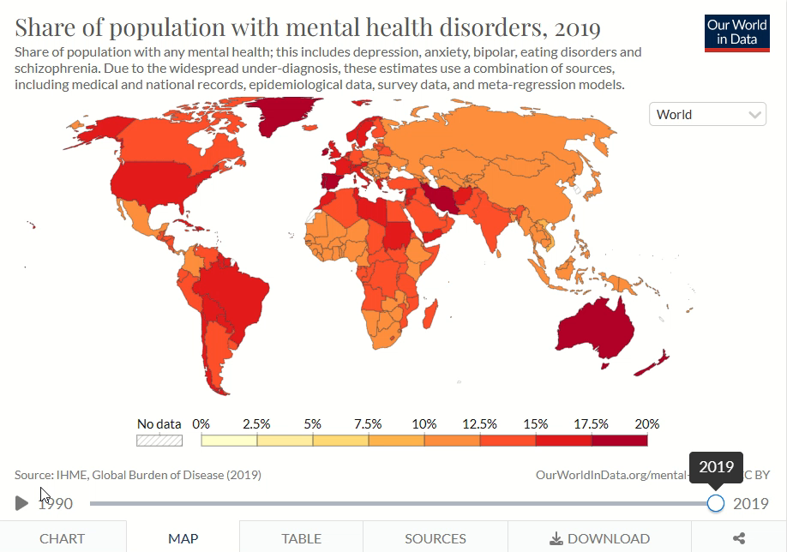

Slide 19
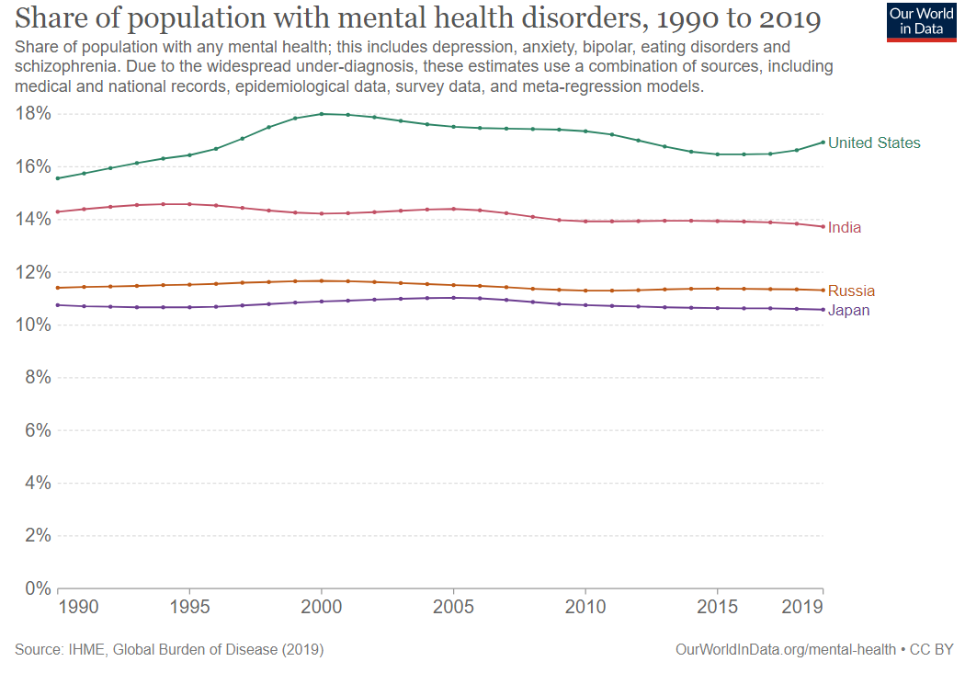

Slide 20
PROBLEM STATEMENT
6

Slide 21
Recommendation system based on user’s preference like books, art, movies, music etc… by analyzing the depression level of a user at a particular session by creating a depression detector.

Slide 22
REFERENCES
7

Slide 23
https://www.researchgate.net/profile/Sarah-Sheikh/publication/341318329_Finding_Behavioural_and_Imaging_Biomarkers_of_Major_Depressive_Disorder_MDD_using_Artificial_Intelligence_A_Review/links/5f4238e3458515b72946d646/Finding-Behavioural-and-Imaging-Biomarkers-of-Major-Depressive-Disorder-MDD-using-Artificial-Intelligence-A-Review.pdf
https://memlab.yale.edu/sites/default/files/files/2016_Chekroud_etal_Lancet(1).pdf
https://www.google.co.in/books/edition/_/xr7hamRLTr0C?hl=en&gbpv=1&pg=PR5&dq=psychology
https://www.google.co.in/books/edition/Care_giving_in_Dementia/X6If9Vk95SsC?hl=en&gbpv=1&dq=psychology&pg=PA67&printsec=frontcover
https://www.who.int/news-room/fact-sheets/detail/mental-disorders
https://www2.psych.ubc.ca/~schaller/LehmanChiuSchaller2004.pdf

Slide 24
Thanks!
ANY QUESTIONS?
dextro.helium3@gmail.com

